Slide 1
C300 Final Evaluation
Team Members: Nur Atikah Nazreen Syakir Mikhail Zhao Liang | Project ID: SOI-Sem1 -2018-1810-0094 Project Title: Food Culture

Slide 2
Agenda
1
Introduction
What is our application about?
2
Project Specification
Functional Requirements, Use Case Diagram, Project Requirement
3
System Design
Entity Relationship Diagram
4
Task Allocation & Progress
Task specialization, Task Allocation & progress, Attendance
5
Prototype
Demonstration Walkthrough

Slide 3
Introduction
Food culture is a web application that allows anyone from around the world to have a personal interactive cultural experience of Singapore hosted by Singaporeans themselves in their homes. Through this application, they are able to have an experience beyond what they can find on the internet simply just by booking a time on a particular day and wait for a host to accept their request!
The host would also not missed out as they will get to meet new people from different background when they place their offer to the tourist. Apart from that, it will be almost like a part-time job as not only Will the host gain new friends, but they will also be paid for their hospitality.

Slide 4
Project Specifications
Functional Requirements
Host
Tourist
Login or Register
Create and manage profile
Upload photos
Receive notification when booking is made near them
View lists of bookings and its details
Make offer on bookings
View past and current offer made and its details
Cancel offer made
Make and view review
Receive notification when Tourist make review about the booking with the Tourist
Chat with Tourist once booking confirm
Make payment for registration
Login or Register
Subscribe to mailing list
Create and manage profile
Upload photos
Make booking to request experience
View past & current booking made and its details
View offer made by Host based on booking and its details
Accept offer/cancel booking
Make payment when booking confirmed
Make and view review
Chat with Host once booking confirm
Receive notification when Host make review about the booking with Host

Slide 5
Project Specifications
Functional Requirements
System
Capture image through IoT
Face recognition/detection
Capture payment details to Paypal
Admin
Manage users (tourist, hosts, add new admin)
Able to view, sort, search, filter by status, or edit user information
Manage mailing list
Manage T&C, Privacy Policies, FAQ, etc.
Manage publishing of review to testimonial
Verify the host
Guest
View testimonial
Explore the webpage
Subscribe to mailing list

Slide 6
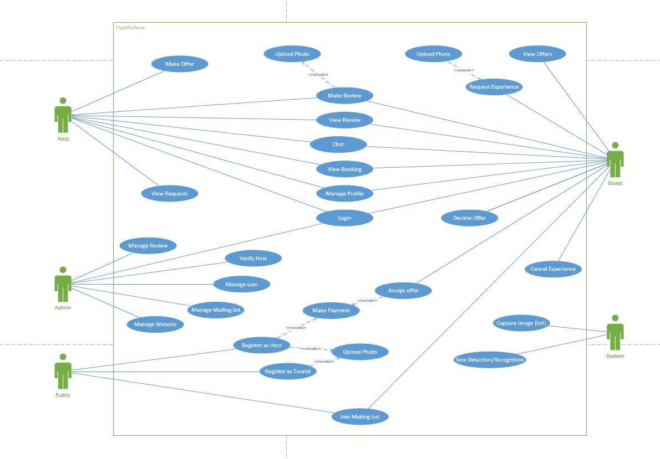
Project Specification - Use Case Diagram

Slide 7



Project Specifications
Project Requirements
Amazon Cloud Server
Using SQL Server on Amazon Cloud to have an online Database up and running
Online Repository on GitHub
Application Language
Using online git repository to push updated codes up to the repository so as to always maintain integration plus a platform of backup codes as well as for version control.
Application is currently running on HTML, CSS and Javascript for the front-end and using the language PHP for its back-end

Slide 8
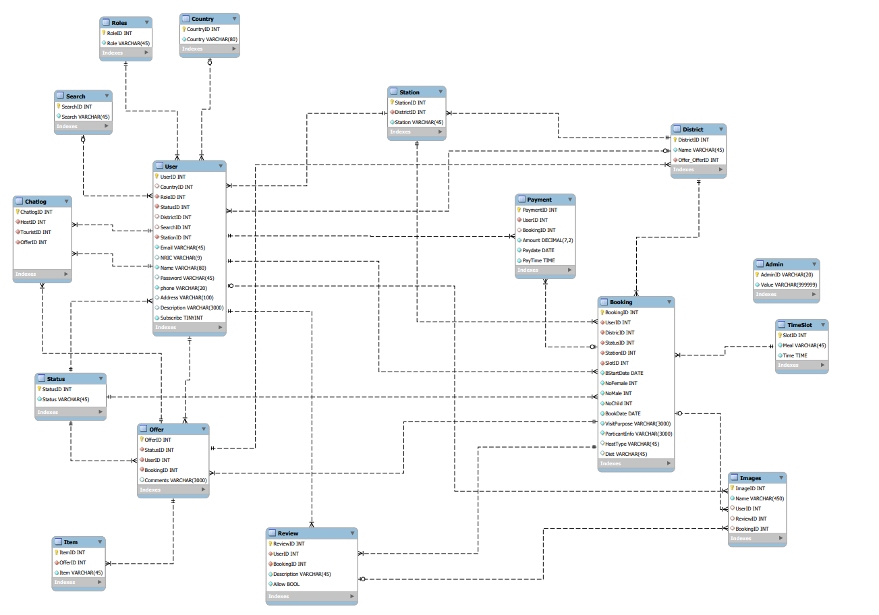
System Diagram ERD

Slide 9
Database Management
Application use: MySQL Workbench, Amazon Web Service EC2, phpMyAdmin
Database was initially set up in phpMyAdmin where all codes and data are done locally in individual laptops.
Any changes in the database will be updated in the ERD as well so that both data are tally with each other.
Cloud database was set up using EC2 as the cloud computing platform that uses linux system to establish a connection with MySQL.
This connection allow the setup of the host, root, password and db name that will be used in our application.

Slide 10

IOT - Capture Image
Users at home will do a verification check of the tourist real time, this will give them a sense of security as they are inviting strangers to their houses
This security measure will be using the raspberry pi
When the visitor at the door:
The camera will capture picture of the visitor
The picture captured will stored as jpg file format
The picture captured will be stored in image folder in the raspberry pi
Using internet connection such as WIFI, the captured image in the folder will be push to the cloud from the raspberry pi side
Since there is a need to verify if it’s the person from the program, the image that was pushed to the cloud will be used for face recognition to check

Slide 11
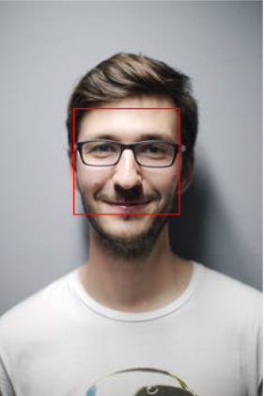
Imaging - Face Detection & Recognition
Receive image in real-time from IOT setup at host’s door:
Run image through facial detection program
Outputs the following data:
x - X coord of the face in the picture
y - Y coord of the face in the picture
width - Width of the face
height - Height of the face
positionX - X position relative to the document
positionY - Y position relative to the document
offsetX - X position relative to the offset parent
offsetY - Y position relative to the offset parent
scaleX - Ratio between original image width and displayed width
scaleY - Ratio between original image height and displayed height
“Face” portion of the image is cropped out and to be used for comparison
Compare image with the ID photo initially submitted during registration

Slide 12

Payment gateway
Payment gateway: Paypal
What is it: A software platform for handling online payments on a regular basis.
Functions for the application:
Create charges
Accept card payments
Identify failed/declined/cancelled payments
View Receipts of transactions
Payment rate:
$40 (USD) → Adults (Male and Female)
$30 (USD) → Children
Why use paypal:
Very widely known payment gateway
Very fast online transaction
Side Note: Database will not store credit card information
Notes:
Side Note: Database will not store credit card information (Privacy issues)
Credit card information will be handled by Paypal

Slide 13
Task Allocation and Progress
Nur Atikah
Tasks | Progress |  | Tasks
Project Planning | 90% | 100% | Website - Create new user
Use Case Diagram | 100% | 70% | Website - Chat Messages
Functional Requirement | 100% | 100% | Website - Send Email
Entity Relationship Diagram | 95% | 70% | Website - Manage Review
Prototype | 100% | 100% | Website - Manage Mailing List
Database Management | 100% | 90% | Website - Mailing List
Running on cloud | 100% | 100% | Integration
Running on application | 100% | 100% | Testing
Website - User Login | 100% | 100% | Report
Website - Home Page (About us, Contact us, How it works, host T&C) | 80%

Slide 14
Task Allocation and Progress
Nazreen
Tasks | Progress |  | Tasks
Entity Relationship Diagram | 100% | 100% | Website - View Booking Details
Prototype | 100% | 100% | Website - Terms and Condition
Website - View & Accept Offer | 100% | 80% | IOT
Website - View Review | 95% | 100% | Capturing of image Uploading image to cloud
Host Tourist | 90% | 65%
 | 100% | 60% | Integration
Website - Submit Review | 95% | 100% | Testing
Host Tourist | 90% | 100% | Report
 | 100%

Slide 15
Task Allocation and Progress
Syakir Mikhail
Tasks | Progress |  | Tasks
Entity Relationship Diagram | 100% | 70% | Website - Rich Text Implementation
Prototype | 100%
Website - Edit Profile |  | 80% | Website - Make Offer
Host Tourist | 90% | 90% | Website - FAQs
 | 90% | 90% | Imaging - Facial Recognition
Website - Register |  | 0% | Imaging - Comparison & Identification
Host Tourist | 100% | 100% | Integration
 | 100% | 100% | Testing
Integration of Face Recognition with Cloud | 60% | 100% | Report

Slide 16
Task Allocation and Progress
Zhao Liang
Tasks | Progress |  | Tasks
Entity Relationship Diagram | 100% | 100% | Website - Privacy policies
Use Case Diagram | 100% |  | Website - View Booking
Prototype | 100% | 100% | Host Tourist
Testing | 100% | 100%
Report | 100% | 90% | Website - Make Booking (Tourist)
Integration | 100% | 100% | Website - Cancel Booking (Tourist)
Payment API |  | 90% | Website - E-receipt
Capture payment from website Make payment | 100% | 80% | Website - View Transactions
 | 100%

Slide 17
Attendance
Records of Team Meetings with Supervisor
Date | 18/04/18 | 25/04/18 | 02/05/18 | 09/05/18 | 16/05/18 | 23/05/18
Atikah | Present | Present | Present | Present | Present | Present
Nazreen | Absent | Present | Present | Present | Present | Absent
Syakir | Absent | Present | Present | Present | Present | Present
Zhao Liang | Present | Present | Present | Present | Present | Present
Date | 30/05/18 | 11/07/18 | 18/07/18 | 25/07/18 | 1/08/18 | 23/05/18
Atikah | Present | Present | Present | Absent | Present | Present
Nazreen | Absent | Present | Present | Present | Present | Absent
Syakir | Absent | Present | Present | Absent | Present | Present
Zhao Liang | Present | Present | Present | Present | Present | Present

Slide 18
Timeline
Current stage of the project
Planning
Analysis
Design
Develop
Testing
Deploy

Slide 19
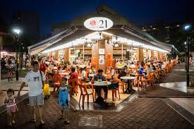
Prototype
Demonstration Walk Through
Food Culture

Slide 20
Thank you

